Slide 1

GENERAL MEETING
CHANGES AT THE LEVEL OF
GRASS ROOTS

Slide 2
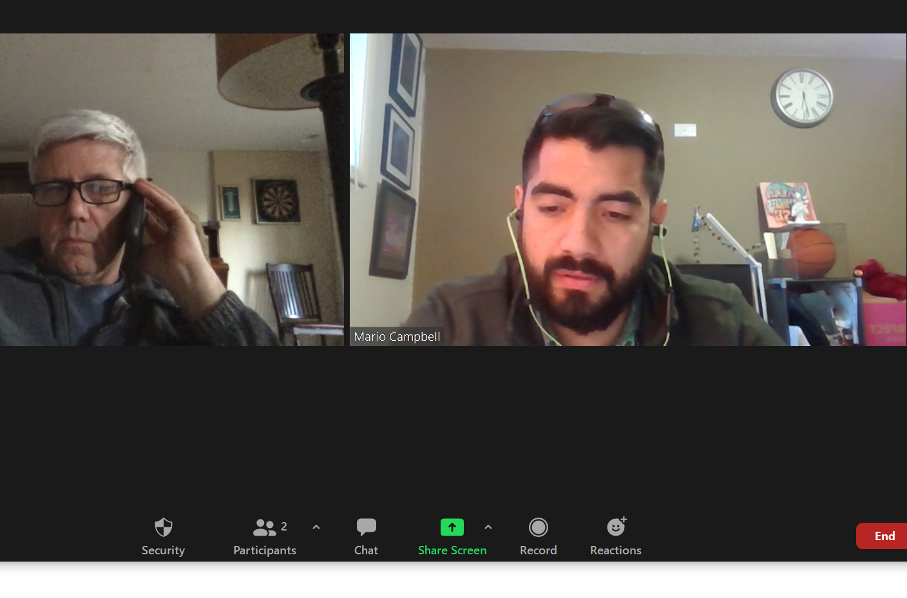
house keeping
  Zoom Items
  Limited Time

Slide 3
AGENDA
INTRODUCTIONS - Self Introductions
  Stafford Hamlet Chair - Bill Markt
  PNA Officers,
  Board, and
  Committee Chairs
PUBLIC COMMENT INVITATION 10 minutes
GUEST SPEAKER
  Lake Oswego School Board 5 min.

Slide 4
AGENDA
4. COMMITTEE REPORTS
  PNA Webmaster Frederique Lavios Website update 5 min.
  PNA Communications Mario Campbell Nextdoor Postings 5 min.
  PNA Emergency Prep Rick Eilers Storm Learnings 5 min.
Mark Thornburg Emergency Messaging 5 min.
Kirsty Reilly Storm Response 5 min.
  PNA Tree Committee Tom Horman Tree permit process 5 min.
  PNA Traffic Committee Kim Beeler Traffic update 5 min.
  N’hood Enhancement Pgm. Al Calabria Neighborhood Signs 5 min.
  Pre-Application Process Mary Palm Pre-App Process 5 min.
5. OLD BUSINESS AND ACTION ITEMS 10 min.

Slide 5
AGENDA
6. NEW BUSINESS
  PNA ELECTION Al Calabria 5 min.
    Electronic only
    Vote for chair and your area rep
    Elected area reps elect Vice Chair, Secretary and Treasurer
    Submit vote by midnight, April 29th
  Other new business Rob Heape 10 min.
    Aquatic & Rec. Center
    Rassekh Park
7. ADJOURN

Slide 6
INTRODUCTIONS
Stafford Hamlet Chair - Bill Markt
PNA Officers, Board and Committee Chairs SELF INTRODUCTIONS
  PNA CHAIR/VICE CHAIR
  SECRETARY - KIM BEELER
  TREASURER - GAIL PARRICK
  AREA REPS
    1. JOHN SURRETT
    2. OPEN
    3. MARIO CAMPBELL
    4. OPEN
    5. OPEN
    6. GAIL PARRICK
    7. OPEN
    8. AL CALABRIA
    9. MARY PALM
    10. KIRSTY REILLY
    11. ROBERT HEAPE
    12. HAROLD RUST
    13. OPEN

Slide 7
INTRODUCTIONS
  PNA Webmaster/E-News Frederique Lavios Website update .
  PNA Communications Mario Campbell Nextdoor Postings
  PNA Emergency Prep Rick Eilers Storm Learnings
Mark Thornburg Emergency Messaging
Kirsty Reilly Storm Response
  PNA Tree Committee Tom Horman Tree permit process
  PNA Traffic Committee Kim Beeler Traffic update
  N’hood Enhancement Pgm. Al Calabria Neighborhood Signs
  Pre-Application Process Mary Palm Pre-App Process

Slide 8
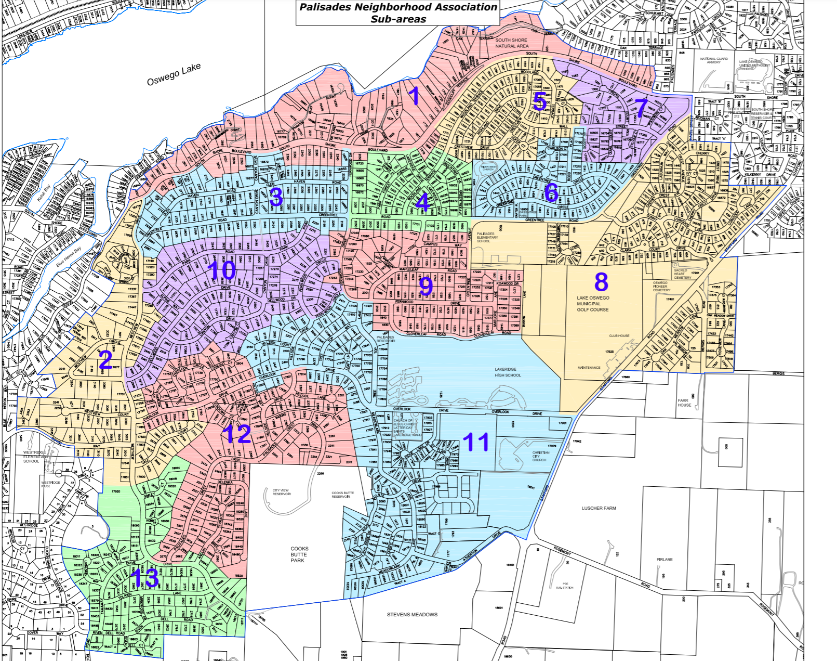
PUBLIC COMMENT

Slide 9
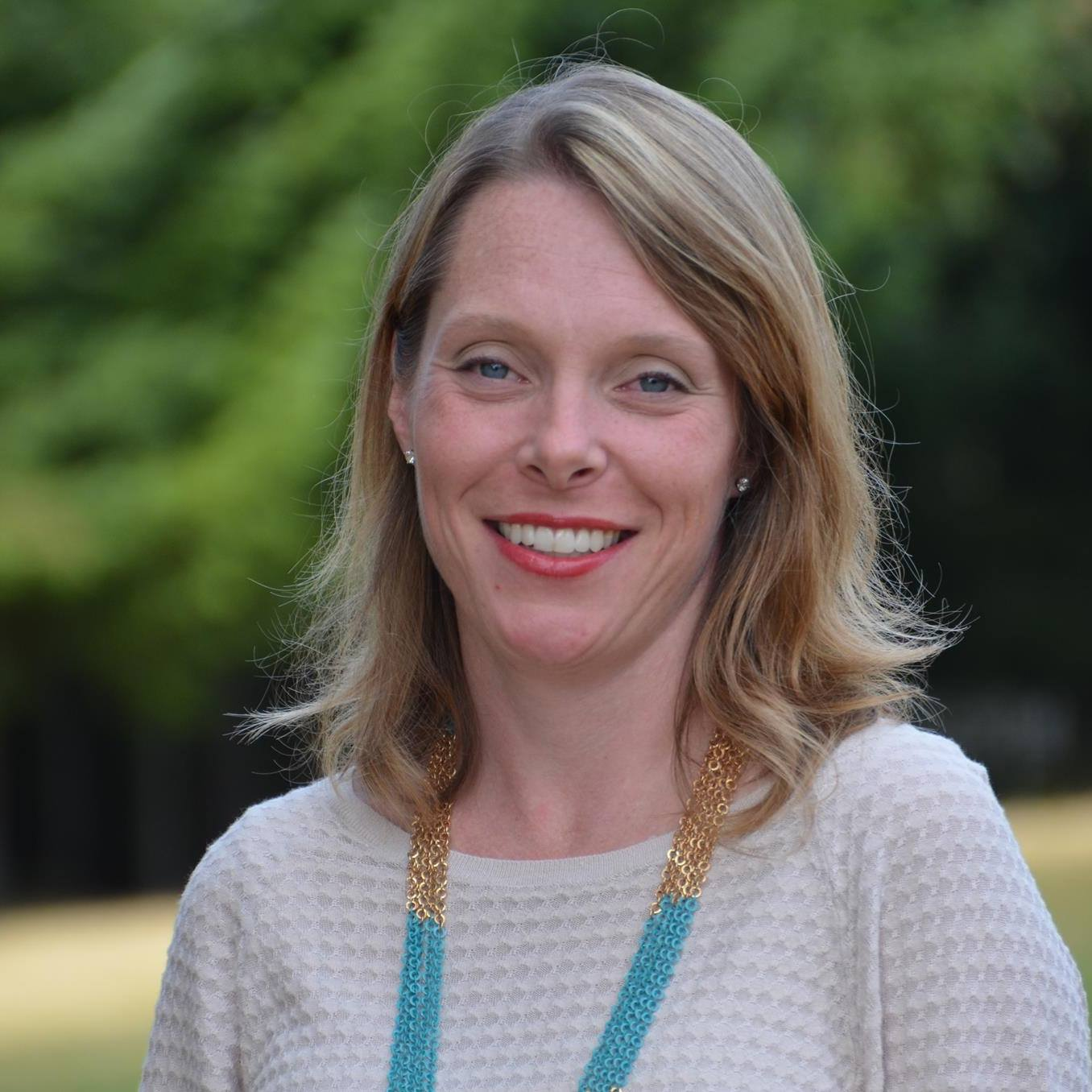

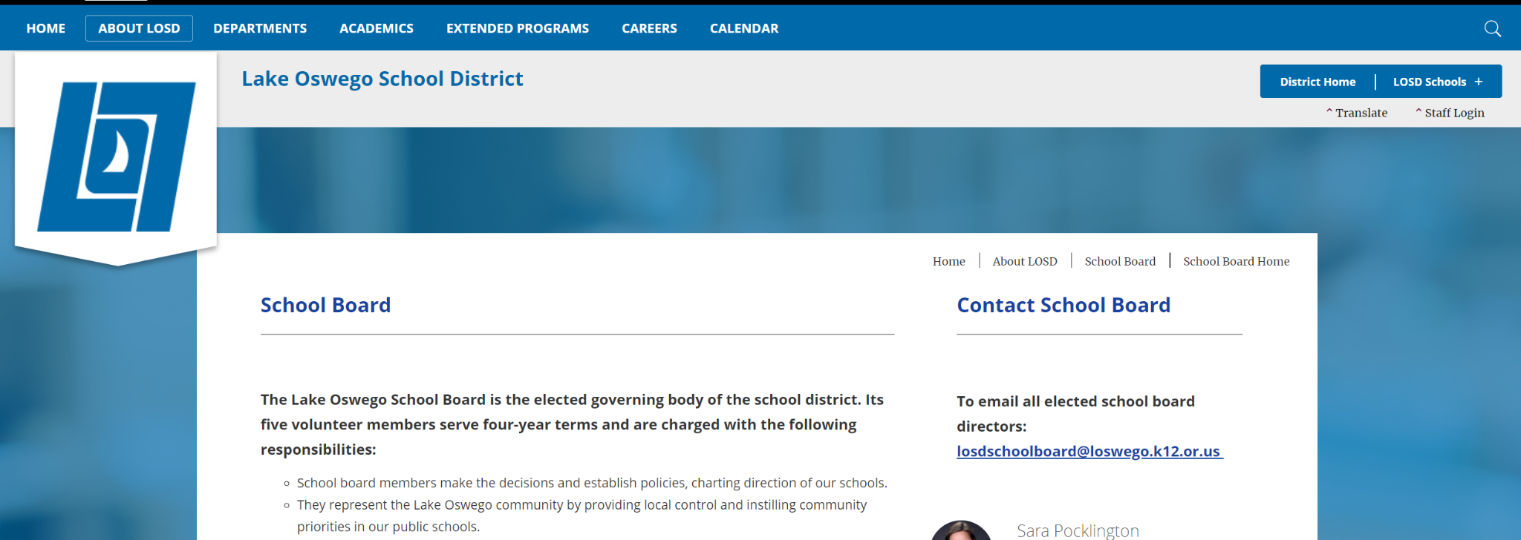
GUEST SPEAKER
Lake Oswego School Board Gail Parrick/Kirsten Aird Update

Slide 10

COMMITTEE REPORTS

Slide 11
COMMITTEE REPORTS
Webmaster/Communications - Frederique/Mario
Changes/Additions
Accessing Ballot
Subscribing to Newsletter
Nextdoor Posts - and any other ideas

Slide 12
COMMITTEE REPORTS
Emergency Prep
Rick Eilers - Storm Learnings

Slide 13
COMMITTEE REPORTS
Emergency Prep
Mark Thornburg- Emergency Messaging

Slide 14
Emergency Radio in the Palisades Neighborhood
Mark Thornburg, KF7KXX
ARRL Assistant Emergency Coordinator

Slide 15
Remember the ice storm?
On Fernwood Circle, we lost power for six days
After about a day, our cable internet (Xfinity) failed. A tree limb brought our cable down to the ground.
Initially, we were able to send and receive email through our cell phones (AT&T).
But as the demand for internet access by cell tower increased, cell companies began to limit the amount of data they would allow to pass over cell towers.
At times, we were unable to place a cellphone call.
We couldn’t leave our property due to the layer of ice on the streets, but at least we had water and natural gas

Slide 16
It could have been worse!
Imagine if we had experienced a damaging earthquake
From the earthquake, we can expect water and gas lines to be broken
We can expect that cell service will be interrupted and that we will be unable to call for a public safety response

Slide 17
The LO Amateur Radio Emergency Service
In Lake Oswego, there are 44 members of the Amateur Radio Emergency Service (LO ARES)
We are located throughout Lake Oswego

Slide 18
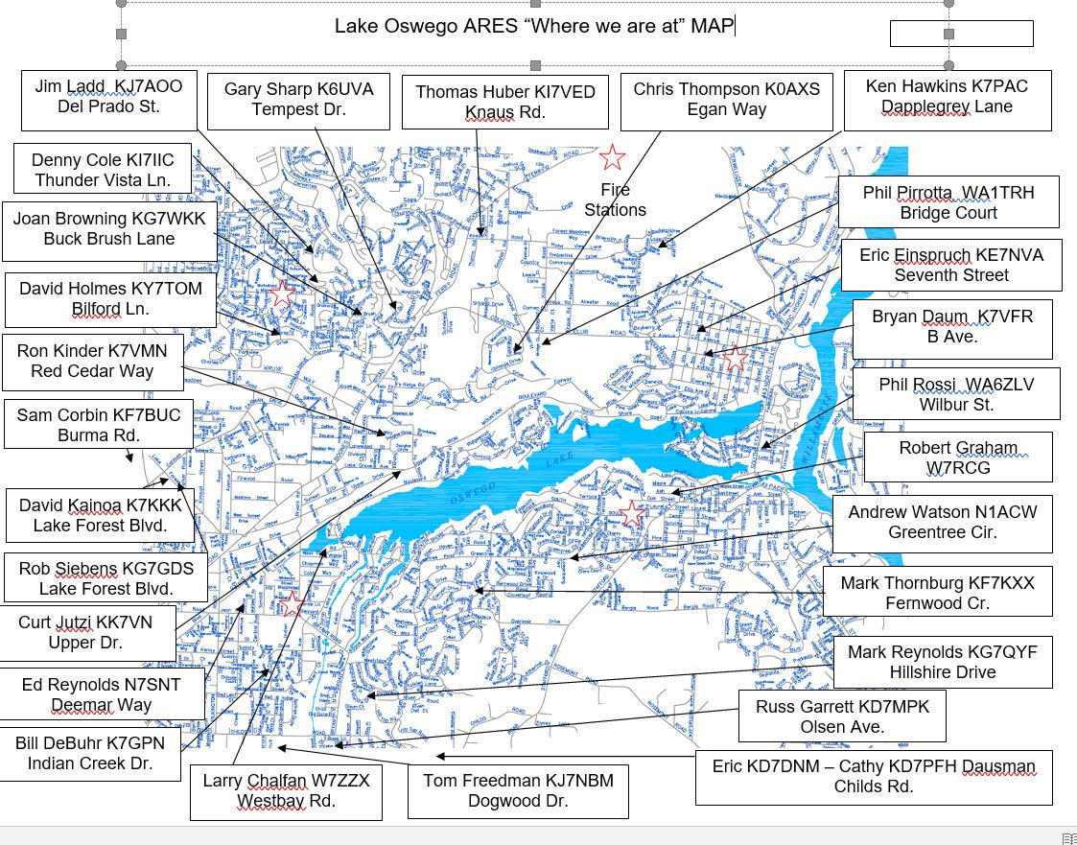

Slide 19
During the ice storm, even without power- LO ARES members established a radio “net” every three hours. Approximately 17 members participated; five different members rotated to act as “net control” stations.
We were successful in sending and receiving information, such as “situation reports” to each other. We were able to share equipment, such as generators

Slide 20
But in a way, we failed:
Our neighbors didn’t know that we existed as a functioning communication network within LO
If they had known, we might have been able to pass important information across the city to the appropriate people

Slide 21
Family Radio Service (FRS) radios
General Mobile Radio Service (GMRS) radios
Inexpensive, easy to use, readily available, do not require a license to operate, proven effective for use within a typical neighborhood
The Lake Oswego Fire Department has created a work group with representatives from LO ARES, Prep-LO, licensed radio operators and neighborhood association leaders to develop a city-wide radio communication plan, along with training resources that can be used by neighborhood associations and citizens alike. It is in development.

Slide 22
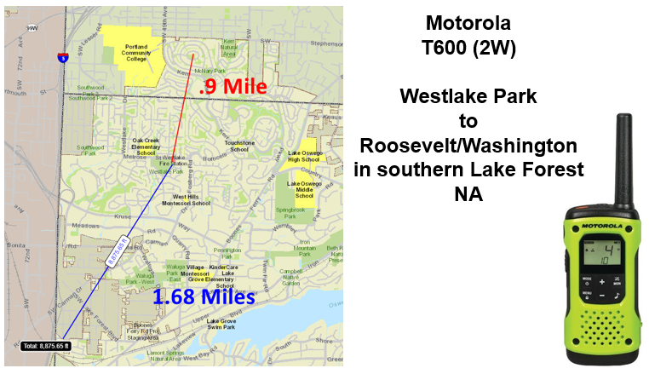

Slide 23
Training resources from this project will include:
A general video on how to operate most FRS/GMRS radios and composing general radio messages
An online meeting where additional information on the plan will be discussed and participants can interact with a panel to answer questions
A series of hosted, in person (socially-distanced) trainings where participants will use radios, and
Documented information that citizens and neighborhoods can utilize to help them plan and coordinate their own basic training

Slide 24
This is work “in progress”
“Neighborhood Communicators,” spread out across the city will have access to radios that are sufficiently powerful to relay information through frequencies used by licensed radio operators in the Lake Oswego Emergency Operations Center (EOC)
“Neighborhood Communicators” will typically have more experience managing radio traffic

Slide 25
We want the community to know:
We have already established emergency radio nets that can reach across large areas of Lake Oswego. We are here.
There is an advantage when more citizens have become trained in radio use.
It is not difficult to become a licensed amateur radio operator. “Friday afternoon-Saturday morning” courses usually provide training sufficient for attendees to pass the “technician-level” Amateur Radio License test

Slide 26
COMMITTEE REPORTS
Emergency Prep
Kirsty Reilly - Storm Response

Slide 27
COMMITTEE REPORTS
Tree Committee - Tom Horman - Role Summary
Act as the primary point of contact, and facilitator, for PNA’s Handling of Type II tree permit applications.
Forward info to, and support, the applicable area rep. for the property involved:
Let the area rep. take the lead on an application that’s in their area, if they want to.
Work with the area rep. if they request it.
Or, if they ask to not be active in a specific application, or give no response, take the lead role in handling it, including any needed on-site activity.
Note: Communication is key, and having both PNA members interacting with the applicant in an uncoordinated manner should be avoided, by communicating openly & timely.
Strive to balance individual property rights with the desired native tree support.
If taking formal action seems warranted, it should be escalated to the PNA chairperson, and the matter should be discussed and decided by the PNA board, prior to taking action.
Basic information should be logged about each request, so that some basic reports and statistics can be generated later, as needed.

Slide 28
COMMITTEE REPORTS
Tree Committee - Tom Horman - What I Have Learned
Started the role on March 26th The following is for the period of 3/26/21 to 4/26/21.
There have been 10 Type II tree permit applications.
None have needed formal action.
None have involved “significant” trees
4 have been approved, and the other 6 are still in-process.
Fairly evenly divided between Outgrown Area, Landscape Improv., and Develop. type apps.
Please send comments or suggestions to: chairperson@palisadesneighborhood.org

Slide 29
COMMITTEE REPORTS
Traffic - Kim Beeler

Slide 30
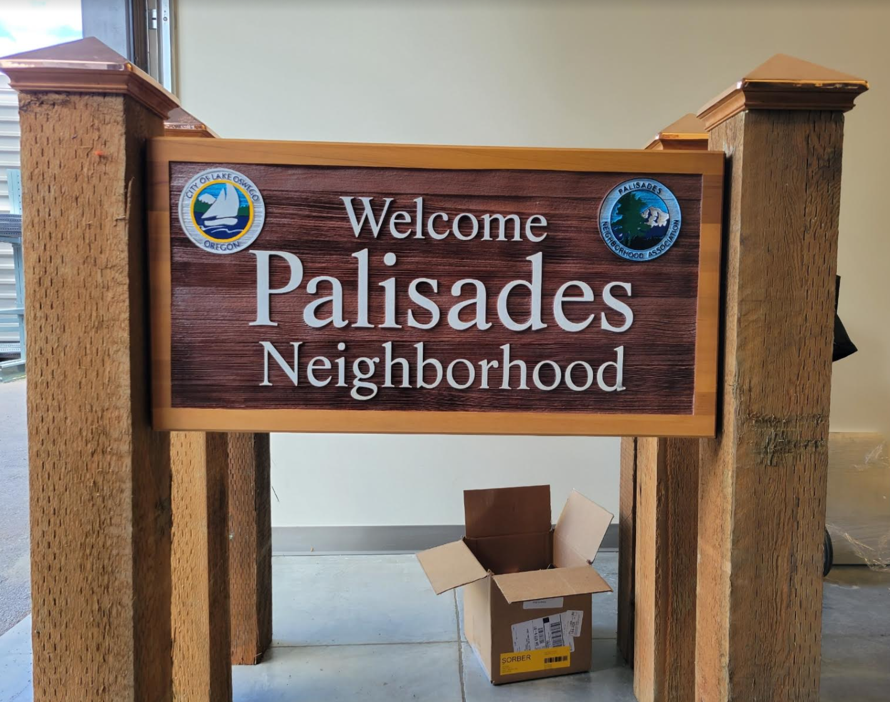
COMMITTEE REPORTS
Neighborhood Enhancement Program - Al Calabria

Slide 31
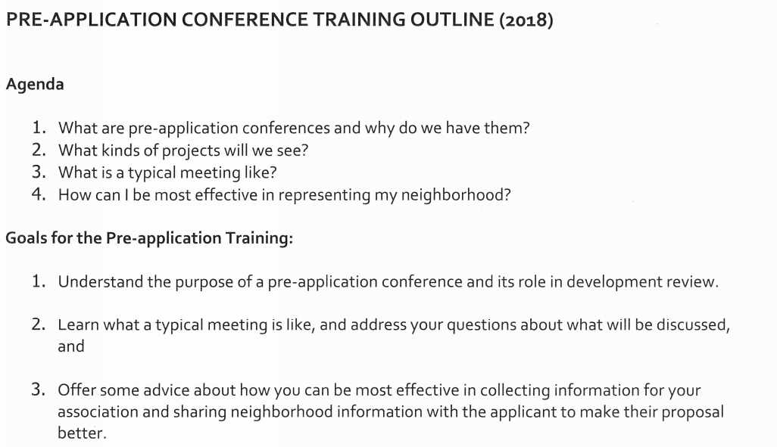
COMMITTEE REPORTS
Pre-Application Process - Mary Palm

Slide 32
OLD BUSINESS & ACTION ITEMS
...

Slide 33
NEW BUSINESS
PNA ELECTION Al Calabria
  Electronic only - Go to www.PalisadesNeighborhood.org
  Vote for chair and your area rep
  Elected area reps elect Vice Chair, Secretary and Treasurer
  Submit vote by midnight, April 29th
  Within 2 weeks of the general election, the board meets and elects the vice chair, treasurer and secretary from the members of the board

Slide 34
NEW BUSINESS
Aquatic & Rec. Center Rob Heape 10 min.
Rassekh Park

Slide 35
ADJOURNMENT

Slide 36
THE ROLE OF PALISADES NEIGHBORHOOD ASSOCIATION (PNA) IN EMERGENCIES
TO THE EXTENT POSSIBLE, PNA’S MAIN RESPONSIBILITY IN AN EMERGENCY IS TO COMMUNICATE TO ALL RESIDENTS:
  WHATEVER IS RELIABLY KNOWN ABOUT THE EXTENT OF DAMAGE
  EFFORTS TO MITIGATE BY CITY AND OTHER AUTHORITIES
  ADVICE ON INDIVIDUAL ACTIONS RECOMMENDED
  RESOURCES AVAILABLE
RESIDENTS SHOULD CHECK PNA WEBSITE, NEXTDOOR PALISADES AND WATCH FOR AN EMAIL BLAST FROM US AFTER YOU OPT-IN THROUGH THE PNA WEBSITE
WHERE APPROPRIATE, SEEK RESOURCES FROM CITY OR OTHER AUTHORITIES FOR SAFETY AND MITIGATION, E.G., BINS FOR DEBRIS
AL CALABRIA
ACTING VICE-CHAIR
PNA

Slide 37
THANK YOU - QUESTIONS
http://www.palisadesneighborhood.org/
Palisades Neighborhood, Lake Oswego, OR – Bringing you news and history about your neighborhood.
● Brief survey that can be administered during the general meeting along these lines:
○ What went well in the meeting and is something you’d like to see continued in future meetings?
○ What did not go well and is something you’d like changed? What changes would you like to see?
○ Was the meeting format effective and if not, what would you change?
○ Are you interested in becoming an area rep for one of the unrepresented areas or in working on one of our committees?
○ Have you signed up on our website for our newsletter?

